Slide 1
Influencer Marketing
ROI Analytics
Evaluating the measurable business value of influencer marketing campaigns
across platforms, creator tiers, and customer segments
6 Datasets
190K+ Records
₹352.85M Revenue Analyzed

Slide 2
02
Problem Statement
Consumer brands are increasing investment in influencer partnerships, but continue to evaluate success using isolated metrics like impressions or follower count. A campaign with millions of impressions may not generate meaningful conversions — while a smaller campaign with an engaged audience can deliver far greater profitability.
Are marketing budgets being allocated efficiently across campaigns?
Which influencers generate the greatest business value?
₹3,528 average order value across 100,000 transactions — the real signal hiding behind vanity metrics like impressions.
Does a larger audience always produce better financial performance?
The Core Question
Are influencer marketing investments translating into measurable, defensible business value — or just visible activity?
Which customer segments contribute the highest long-term value?
02

Slide 3
03
Objectives
Evaluate influencer marketing effectiveness and translate campaign data into strategic, data-driven marketing decisions.
1
Financial Performance
2
Top-Value Campaigns
3
Influencer Effectiveness
Evaluate revenue, cost, conversions, and ROI across all 10 campaigns and 60 influencer-campaign pairings.
Identify the campaigns generating the highest business value, and the factors behind their success.
Assess influencer impact across 3 platforms, 4 tiers, and audience-location match quality.
4
Customer Insights
5
Product Performance
6
Strategic Recommendations
Examine 90,000 customer demographics and purchasing behaviour to find high-value segments.
Determine which of the 25 products and 5 categories drive the most revenue.
Deliver actionable, data-backed guidance mapped to expected business benefit.
03

Slide 4
04
Solution Overview — High-Level Approach
Six interconnected datasets — campaigns, influencers, campaign performance, orders, customer demographics, and products — were integrated into a single analytical workflow, moving from raw data to an executive-ready decision tool.
1
2
3
4
5
Integrate
Assess & Clean
Explore
Visualize
Recommend
Merge 6 linked datasets (190K+ records) into one relational structure
Data quality checks, IQR outlier review, structural-null documentation
Univariate, bivariate & correlation analysis; KPI engineering (ROI, CPA)
Interactive Streamlit + Plotly dashboard with filters & drill-downs
Evidence-based recommendations tied to business impact
04

Slide 5
05
Tool Stack
Py
Python
Pd
Pandas & NumPy
Viz
Matplotlib & Seaborn
Data preparation and analysis
Joins, validation, KPI calculations
Exploratory visual analysis
St
Streamlit & Plotly
Xl
Excel workbooks
Interactive dashboard and filters
Source datasets — 6 files, 190K+ rows
05

Slide 6
06
Dashboard Features
1
KPI Summary Cards
Total revenue, cost, profit, ROI, conversions, and AOV at a glance
2
Campaign & Influencer Comparison
Rank campaigns and creators side by side on revenue and efficiency
3
Platform & Tier Breakdowns
Compare Instagram / TikTok / YouTube and Nano–Mega tier performance
4
Interactive Filters & Drill-Downs
Slice by platform, influencer tier, campaign, and product category
Influencer Marketing ROI Analytics | Group 9
06

Slide 7
07
Workflow / System Architecture
6 Excel
Workbooks
Data Quality
Assessment
Cleaning &
KPI Engineering
Exploratory
Data Analysis
Streamlit
Dashboard
Business
Insights Report
Source data
Colab notebook
Pandas / NumPy
Colab notebook
Plotly + filters
Recommendations
Linear pipeline: source data → validation → engineered KPIs → visual analysis → interactive dashboard → decision-ready recommendations.
Underlying Data Model
Scale of Analysis
influencers & campaigns → influencer_campaign_performance (60 rows)
influencers, campaigns, customers, products → orders (100,000 rows)
190,115 total records across 6 tables, spanning Jan 2024 – Sep 2025 (21 months of campaign & transaction history)
07

Slide 8
08
Dataset Overview & Preprocessing
6 Linked Datasets — 190,115 Records
0
Duplicate rows across all 6 tables
campaigns
10
Campaign master
influencers
20
Influencer master
0
Broken foreign-key references (7/7 checks passed)
influencer_campaign_performance
60
ROI / conversions fact
orders
100,000
Transaction fact
100%
Referential integrity maintained
customer_demographics
90,000
Customer master
products
25
Product master
1
Structural null field — documented, not an error
Time span: Jan 2024 – Sep 2025 (21 months)
Outliers (IQR method) were investigated, not blindly removed — e.g. ROI outliers traced to genuinely low-cost Nano/Micro influencers, not data errors.
08

Slide 9
09
Data Quality Checks — Methodology & Findings
1. Missing Values
2. Duplicates & Key Uniqueness
3. Referential Integrity
df.isnull().sum() across all 6 tables. 5 of 6 datasets: 0 missing values. Only exception is Main_Product_ID (Campaign Performance) — structurally null, not a defect.
df.duplicated() plus PK checks on all 5 ID columns and the composite (Influencer, Campaign) key. Result: 0 duplicate rows, 0 duplicate keys anywhere.
Every foreign key checked against its parent table's primary key across 7 relationships (Orders, Campaign Performance). Result: 7/7 passed, 0 broken references.
4. Data Types, Dates & Business Values
5. Categorical Consistency
6. Outlier Detection (IQR)
dtype review, Start_Date > End_Date check, zero/negative checks on Price/Budget/Revenue, and Total_Amount reconciliation. Result: 0 issues; amounts reconcile to the cent (1e-12 float noise only).
Sorted unique values inspected per categorical column (Gender, Platform, Tier, Category, Channel, Income_Bracket) for typos/case mismatches. Result: none found — all category sets are clean.
IQR method (1.5×IQR) applied to every numeric column across all 6 tables. Result: outliers concentrated in ROI, Order Quantity, and high-value orders/customers — each investigated, not blindly removed (see next slide).
09

Slide 10
10
Issue Log — Anomalies & Resolution Logic
1. Structural Null (Main_Product_ID)
2. Four Inactive Influencers
3. ROI Statistical Outliers
36 of 60 rows (60%) in Campaign Performance. Expected when a campaign promotes a Category/Collection, not one SKU. Included as-is; product rollups fall back to Campaign's Product_Category.
INF011, INF013, INF015, INF018 have zero tracked activity. Retained in the influencer master table for completeness, but excluded from ROI/performance leaderboards and flagged as “no campaigns run.”
12 of 60 rows (20%) flagged by IQR. Traced to 8 Micro- and 4 Nano-tier influencers with the lowest cost base (₹900–₹3,000) — small denominators inflate ROI%. Included as valid; reported alongside absolute Revenue and Cost.
4. Orders.Quantity IQR Outliers
5. High-Value Order & Customer Outliers
6. No Post-Level Engagement Data
10,961 of 100,000 orders (11%) flagged. Quantity is nearly constant at 1 (mean 1.14), so IQR bounds collapse and flag any order of 2+ units. A method artifact, not a genuine anomaly — excluded from cleaning action, documented only.
Discount_Amount, Total_Amount, Lifetime_Value, Avg_Order_Value — 2.5%–3.6% each. Reflect genuine high-value orders/customers, not errors. Total_Amount independently reconciles exactly (0 mismatches); included as real data.
Impressions, clicks, and likes were never collected at source, limiting direct “fake engagement” detection. Documented as a dataset limitation; approximated instead via the ROI/cost-efficiency outlier check (Item 3).
10

Slide 11
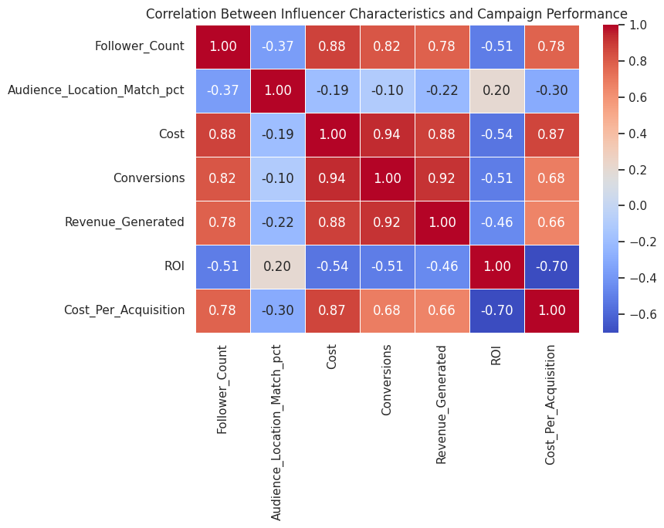
11
Exploratory Data Analysis
Cost ↔ Conversions
r = 0.94
Higher-investment campaigns drive more conversions
Cost ↔ Revenue
r = 0.88
Spend scales with revenue, but not proportionally with ROI
Follower Count ↔ Revenue
r = 0.78
Bigger audiences help — but explain less than cost efficiency does
ROI ↔ Cost per Acquisition
r = −0.70
Strongest inverse link: costly acquisitions erode profitability
Audience Match ↔ ROI
r = 0.20
Correlation matrix — influencer & campaign performance metrics
Weak positive link — targeting alone doesn't guarantee efficiency
11

Slide 12
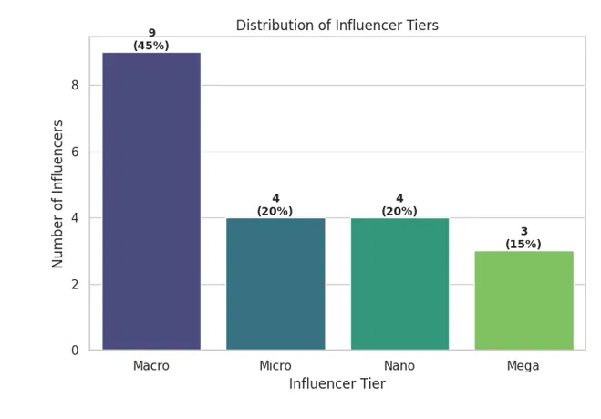
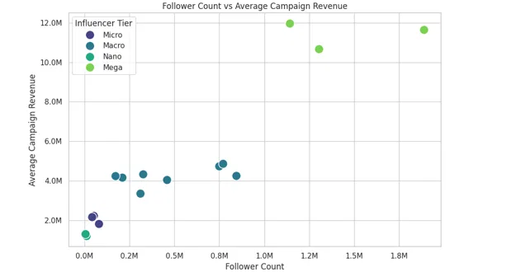
13
Influencer Tier Mix & Revenue Relationship
45% of influencers are Macro-tier.
Micro and Nano influencers each account for 20%, and Mega influencers for the remaining 15%. The roster leans toward mid-sized creators who balance audience reach with campaign affordability, while all four tiers stay represented enough for a full performance comparison.
Revenue rises with follower count.
Mega influencers consistently generate the highest average campaign revenue, exceeding ₹10M. Macro influencers sit in the middle at roughly ₹3.3M–₹4.9M, while Micro and Nano influencers trail behind, reflecting their smaller audience reach.
13

Slide 13
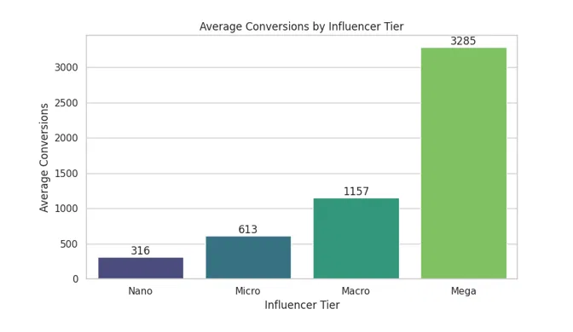
14
Average Conversions by Influencer Tier
Conversions climb steadily with tier size.
Average conversions rise from 316 (Nano) and 613 (Micro) to 1,157 (Macro) and 3,285 (Mega). Larger audiences translate into more customers taking action, making broader-reach tiers the strongest driver of raw conversion volume.
Scale isn't the full story.
Mega influencers generate the most conversions and revenue, but their higher campaign costs mean they don’t automatically deliver the best ROI — efficiency, not just reach, determines real business value.
14

Slide 14
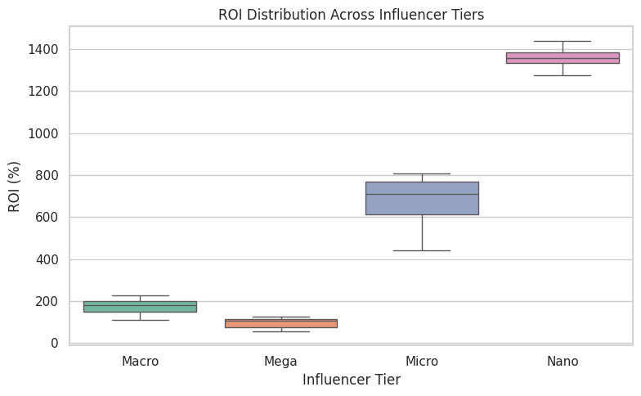
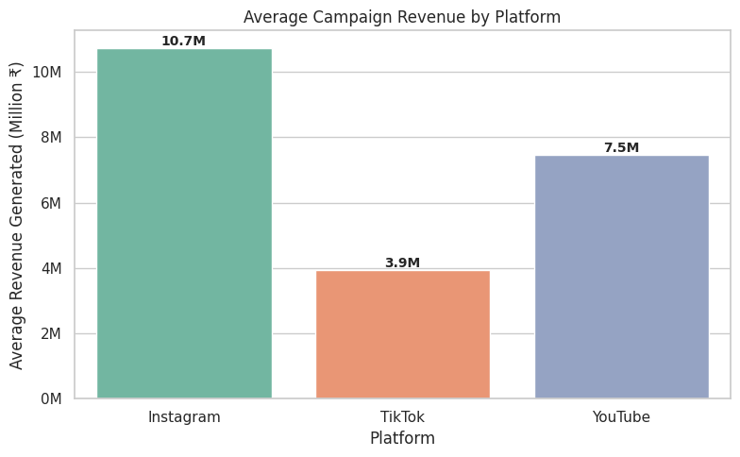
12
Data Visualization & Insights
Nano influencers post the highest median ROI (>1,300%), while Mega influencers — despite the highest revenue — post the lowest ROI (<100%).
Instagram leads at ~₹10.7M revenue per campaign; TikTok trails on volume (~₹3.9M) but is the most cost-efficient platform per rupee spent.
12

Slide 15
15
Strategic Business Insights
Budget ≠ Success
Scale vs. Efficiency
Instagram Wins on Revenue
Higher spend usually meant higher revenue, but several moderate-budget campaigns matched top performers — execution and audience targeting matter as much as budget size.
Mega influencers post ₹10–12M average revenue and the most conversions; Nano influencers post the highest ROI. No single tier wins on every metric.
Instagram averages ₹10.7M per campaign vs. ₹7.5M on YouTube and ₹3.9M on TikTok — platform choice measurably shifts campaign outcomes.
Core Customer: 26–35, Medium-Income
Value Beyond the Sale
A Diversified Wardrobe
This age band drives the largest share of revenue, and medium-income shoppers outspend both low- and high-income segments, while gender contribution stays evenly balanced.
BudgetStylist, MinimalistMan, and TheStreetLook acquire customers with the highest lifetime value — proof that revenue alone misses long-term customer quality.
Luxury edges out other styles only slightly; demand spreads broadly across Streetwear, Boho, Casual, Athleisure, and Formal — no single style dominates.
15

Slide 16
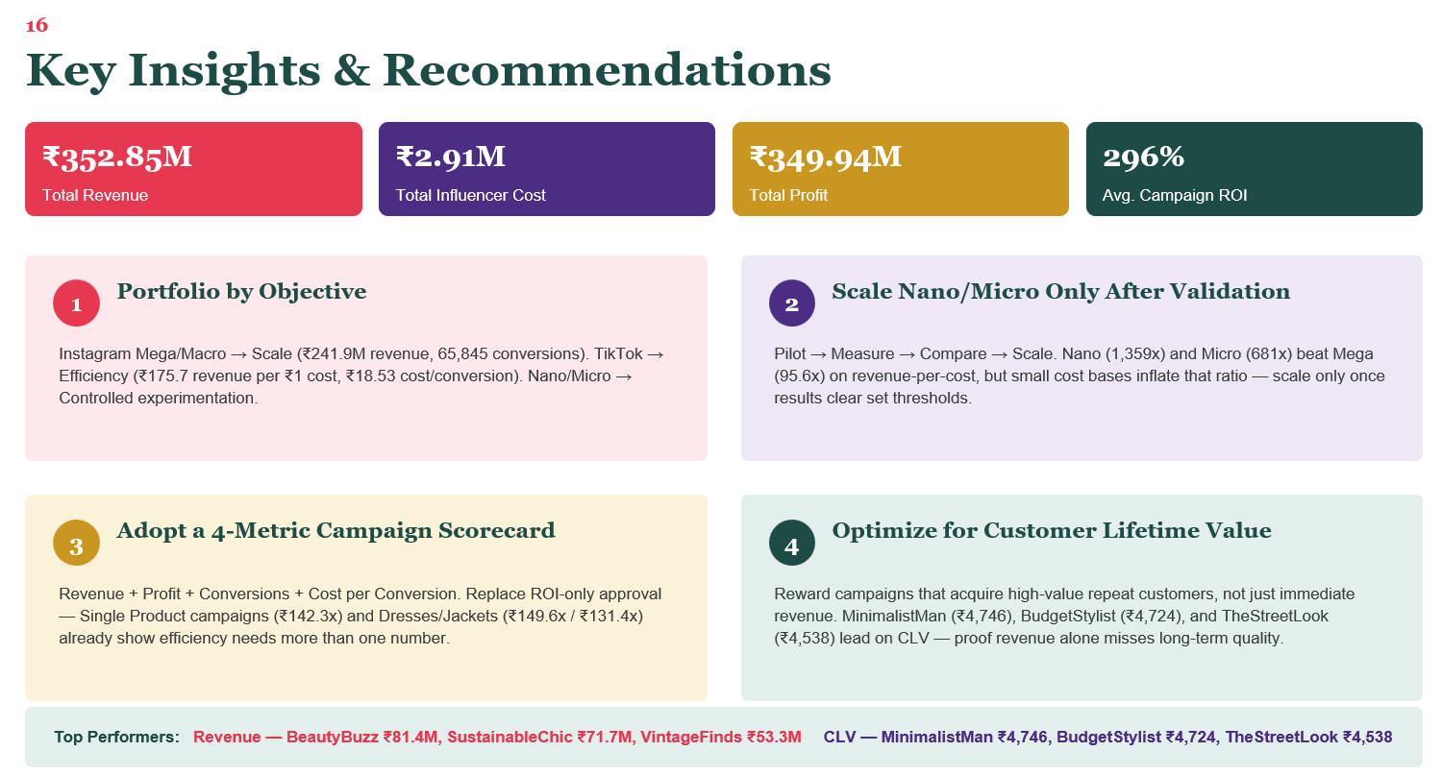

Slide 17
17
Challenges & Learnings
No Engagement-Level Data
ROI Outlier Interpretation
Impressions, clicks, and likes weren't in the source data, limiting true “fake engagement” detection.
12 of 60 performance rows (20%) flagged as ROI outliers by the IQR method.
Resolution: Approximated with ROI / cost-efficiency outlier analysis instead.
Resolution: Traced to genuinely low-cost Nano/Micro influencers — retained as valid, not removed.
Correlation ≠ Causation
Large-Scale Data Handling
Strong correlations (e.g. Cost ↔ Conversions, r=0.94) don't prove incremental lift.
100,000 orders and 90,000 customer records required efficient joins and validation.
Resolution: Flagged explicitly; recommended holdout/matched-comparison testing for next cycle.
Resolution: Vectorized Pandas operations and systematic key-integrity checks throughout.
17

Slide 18
18
Project Demo & Repository
Live artifacts backing this presentation:
</>
Data_Quality_Assessment.ipynb
Google Colab notebook — missing values, duplicates, referential integrity, outlier detection
</>
EDA.ipynb
Google Colab notebook — statistical summaries, correlation analysis, KPI engineering, 10+ visualizations
</>
Streamlit Dashboard
Interactive executive dashboard — KPI cards, platform/tier/campaign comparisons, live filters
Demo flow: open notebooks to walk through cleaning → EDA → launch Streamlit dashboard live → filter by platform/tier to show KPI cards update in real time.
18

Slide 19
19
Conclusion & Future Scope
Influencer marketing should be managed as a strategic investment, not a promotional line item. Campaign success depends on the combined influence of influencer selection, platform, customer fit, and marketing efficiency — not budget size alone. A data-driven, portfolio-based approach lets the organization scale confidently while protecting profitability.
Future Scope
Capture post-level impressions, clicks & engagement to enable true engagement-quality analysis
Introduce holdout / matched-comparison groups to measure incremental lift, not just attribution
Scale Nano/Micro influencer pilots only once defined revenue & efficiency thresholds are cleared
Refresh the 4-metric scorecard (revenue, profit, conversions, cost/conversion) each campaign cycle
12,035%
21
90,000
Blended Portfolio ROI
Months of Data Analyzed
Customers Profiled
Thank you — Questions?

